Slide 1
GDP Prediction
Sophia Wu
2021 Summer

Slide 2

GDP CHANGE
What is Economic Cycle in the US?
Are we able to predict the GDP change?

Slide 3
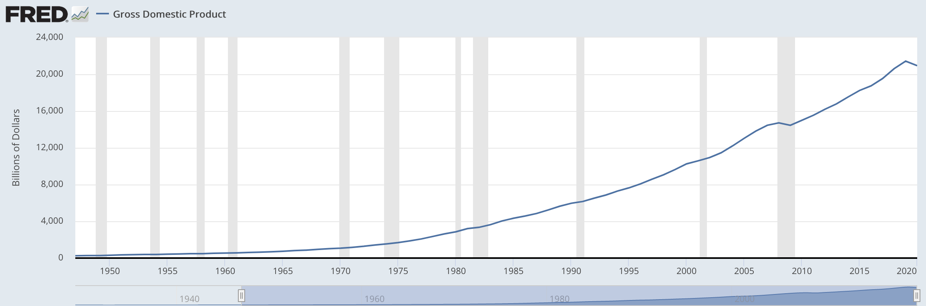
Gross Domestic Product Annual
GDP Growth trending in the United States from 1947 till now Source: U.S.Bureau of Economic Analysis

Slide 4
Dataset
Variables | Type
DATE | Date
GDP per capita | Int
Income receipt | float
gross income | float
Profit before tax | float
gdp change | float
This data is from FRED Economic Research linked here https://fred.stlouisfed.org/categories/106
75 years quarterly data from 1947 to 2021
6 variables listed on the left
Response variable is gdp change

Slide 5
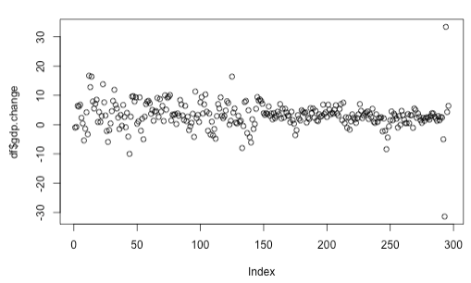
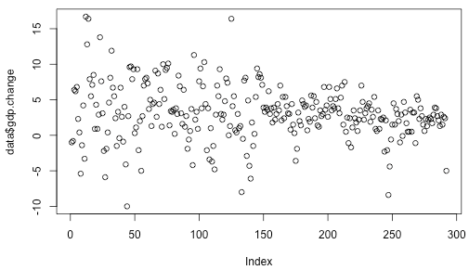
Clean the data
Plot the response variable gdp.change, we may see some outliers which was affected by the COVID. We decided to get rid of the data from the year 2020.
Outlier
Outlier
Before cleaning the data
After cleaning the data

Slide 6
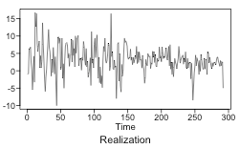
Checking stationarity 1
Condition 1:
Wandering and oscillating behavior
Only one realization not knowing much
The assumption of constant mean seems like not appear to be violated.

Slide 7
Checking stationarity 2
Condition 2:
It is tough to confirm whether there is constant variance since we only have one realization. It seems like there is some tendency to make big jumps in the middle to time series, indicating non-constant variance over time.

Slide 8
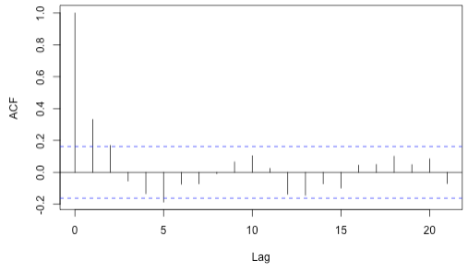
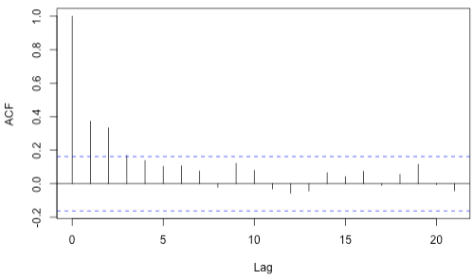
Checking stationarity 3
First half acf
Second half acf
Condition 3: The first half of acf seems like little different from the second half of acf, but not much.
Conclusion: Based on the above analysis, there is some evidence showing non-stationary. But GDP change might be possibly stationary in the long term. We will analyze it using both stationary and non-stationary models.

Slide 9
Stationary model: ARMA
aic5.wge(data$gdp.change,type = "aic", p=0:5, q=0:5)
aic5.wge(data$gdp.change,type = "bic", p=0:5, q=0:5)
p | q | bic | aic
4 | 3 | 2.6 | 2.546052
0 | 2 | 2.596638 | 2.558863
AIC picks ARMA(4,3) and BIC picks ARMA(0,2), showing ARMA(4,3) or ARMA(0,2) might be good fitting stationary models.

Slide 10
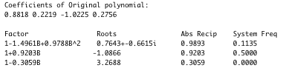
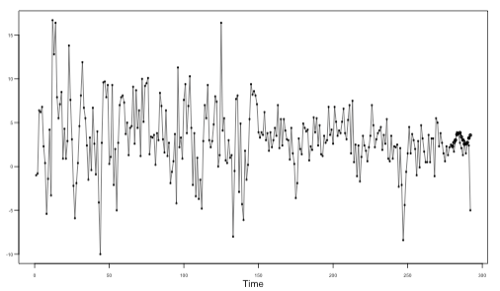
Model ID: ARMA(4,3)
Model ID | Short term ASE | Long term ASE
ARMA(4,3) | 37.968 | 6.879
When fitting a stationary ARMA(4,3) model, the roots values are 0.98, 0.92 and 0.3, which are inside of the unit circle which indicates non-stationarity.
Forecast from ARMA(4,3) stationary models have an attraction to the mean value.

Slide 11
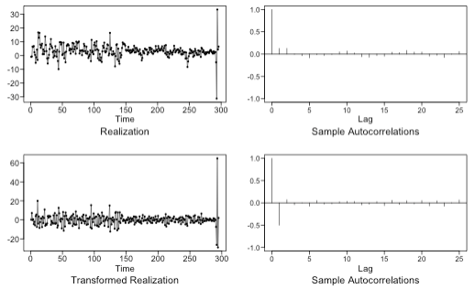
Non-stationary model: ARIMA
p | q | bic | aic
5 | 1 | 3.309525 | 3.234536
4 | 0 | 3.340290 | 3.277799
3 | 0 | 3.335602 | 3.285609
This data might be non-stationary, we first difference the data, it looks like more stationary after transforming data once.
We run aic5 with differenced data, AIC and BIC both select ARMA(5,1), showing ARIMA(5,1,1) might be a good fitting non-stationary models.

Slide 12
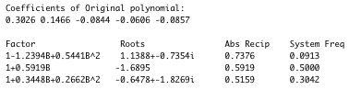
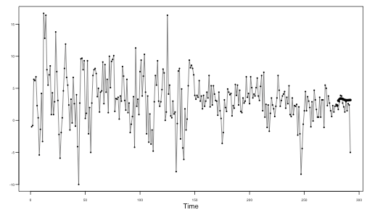
Model ID: ARIMA(5,1,1)
Model ID | Short term ASE | Long term ASE
ARIMA(5,1,1) | 35.09 | 6.515
When fitting a non-stationary ARIMA(5,1,1) model, the roots values are inside of the unit circle.
Forecast from ARIMA(5,1,1) model is very close to the mean value.

Slide 13
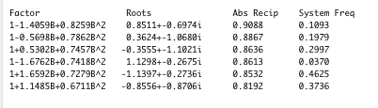
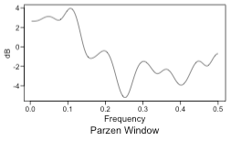
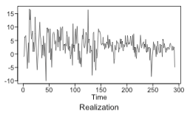
Seasonal Model with s=27
Seasonal model suspected with s=27 ,or possible 9
1/0.037=27
1/0.1093=9

Slide 14
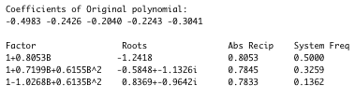
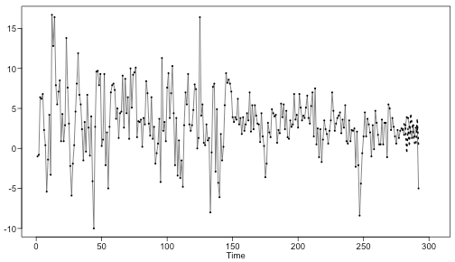
Model ID: ARUMA(5,1,0) s=27
Model ID | Short term ASE | Long term ASE
ARUMA(5,1,0) | 14.18755 | 6.365055
When fitting a non-stationary ARUMA(5,1,0) model, the roots values are inside of the unit circle.
Forecast from ARUMA(5,1,0) model is very close to the mean value.

Slide 15
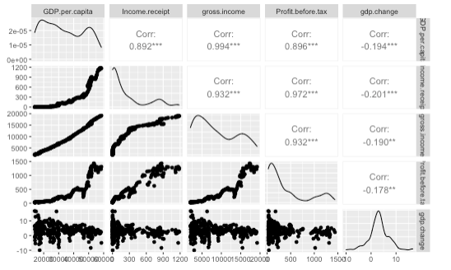
Multivariate Analysis
Five variables:
GDP.per.capita
Income.receipt
Gross.Income
Profit.before.tax
Gdp.change (response variable)
The top two significant variables are GDP.PER.CAPITA and Income.receipt with correlation of -0.2 and -0.194

Slide 16
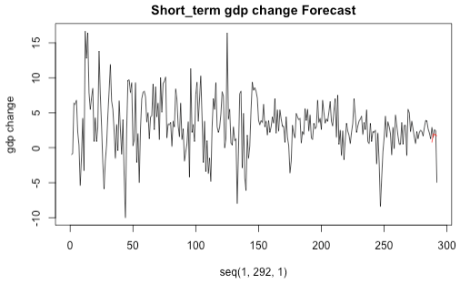
Multivariate Analysis: VAR Model
Model | Short term ASE | Long term ASE | AIC
VAR | 25.89586 | 5.151207 | 7177.838
We selected the top two significant variables to build the VAR model
GDP.per.capita
Income.receipt
Short-term Forecast from VAR model is very close to the last two values.

Slide 17
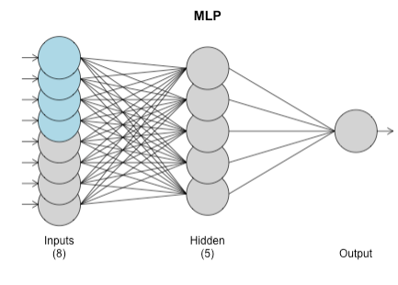
Neural Network: MLP
Model | Short term ASE | Long term ASE
MLP | 15.1618 | 6.274882
Again we selected the top two significant variables to build the Neural network model
GDP.per.capita
Income.receipt
MLP fit with 5 hidden nodes and 20 repetitions. Forecast combined using the median operator. MSE: 7.5201.

Slide 18
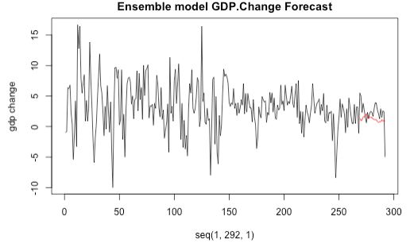
Ensemble Model
Model | Short term ASE | Long term ASE
Ensemble | 16.25906 | 4.78
The forecast from the ensemble model performs the best for the long-term period with the lowest ASE 4.78, the forecast is a little below the mean value.

Slide 19
Model comparison
Model ID | Short term ASE | Long term ASE
ARMA(4,3) | 37.968 | 6.879
ARIMA(5,1,1) | 35.09 | 6.515
ARUMA(5,1,0) s=27 | 14.18755 | 6.365055
VAR | 25.89586 | 5.151207
MLP | 15.1618 | 6.274882
Ensemble | 16.25906 | 4.78
For short term forecast, we may see ARUMA(5,1,0) with s=27 shows best performance with lowest ASE 14.18755;
For long-term forecast, ensemble model shows the best performance with the lowest ASE 4.78.

Slide 20
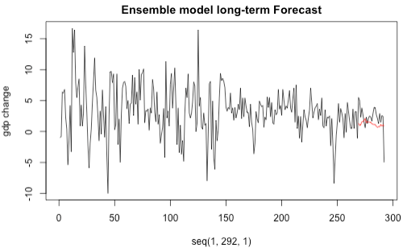
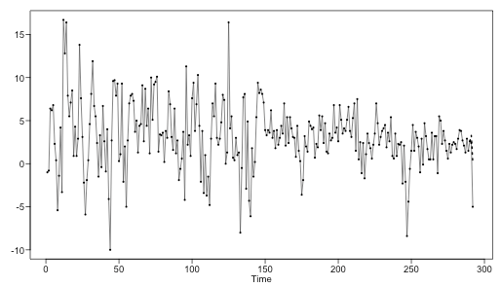
Best Forecast
For short-term: ARUMA(5,1,0) S=27
For long-term: ensemble model
During the different terms, each model performs differently. Some models perform better in the short-term, and some models perform better in the long-term.

Slide 21
Summary
GDP data is very difficult to predict, and models are not able to capture variance in this data.
For the short-term forecast, we may see ARUMA(5,1,0) with s=27 shows better performance with lowest ASE 14.18755;
For the long-term forecast, the ensemble model shows the better performance with the lowest ASE 4.78.
After all, we can't simply say which model is better than the other as they perform differently in the different periods.

Slide 22

Thank you !

